Slide 1
Upcycling project
Lea Zrno 7.a

Slide 2
Upcycling
taking something we normally recycle and transforming it into something more valuable
useful because we make new and useful things from old ones, which helps protect nature, save money and have fun

Slide 3
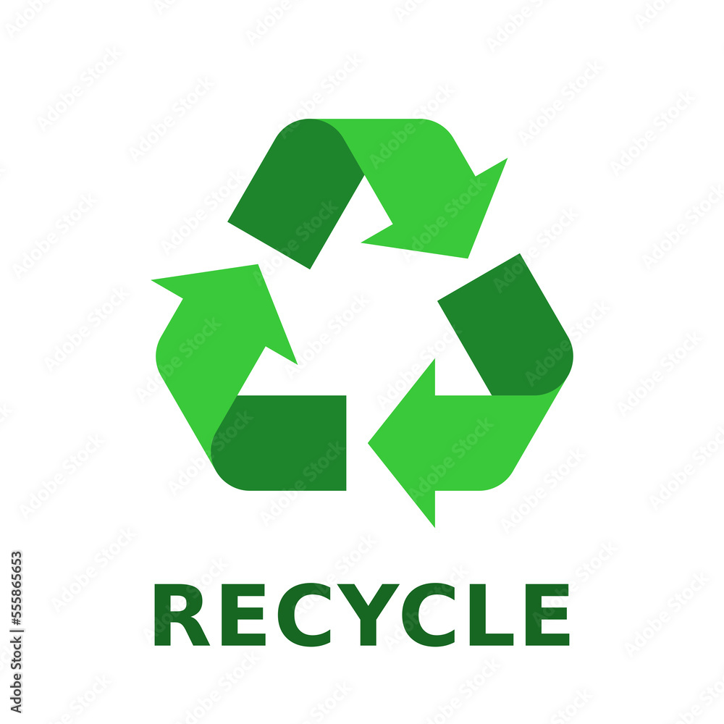
Recycling
turning what we normally throw away into something we can use again either in its current form or as something else
useful because it keeps the Earth clean and saves natural resources

Slide 4
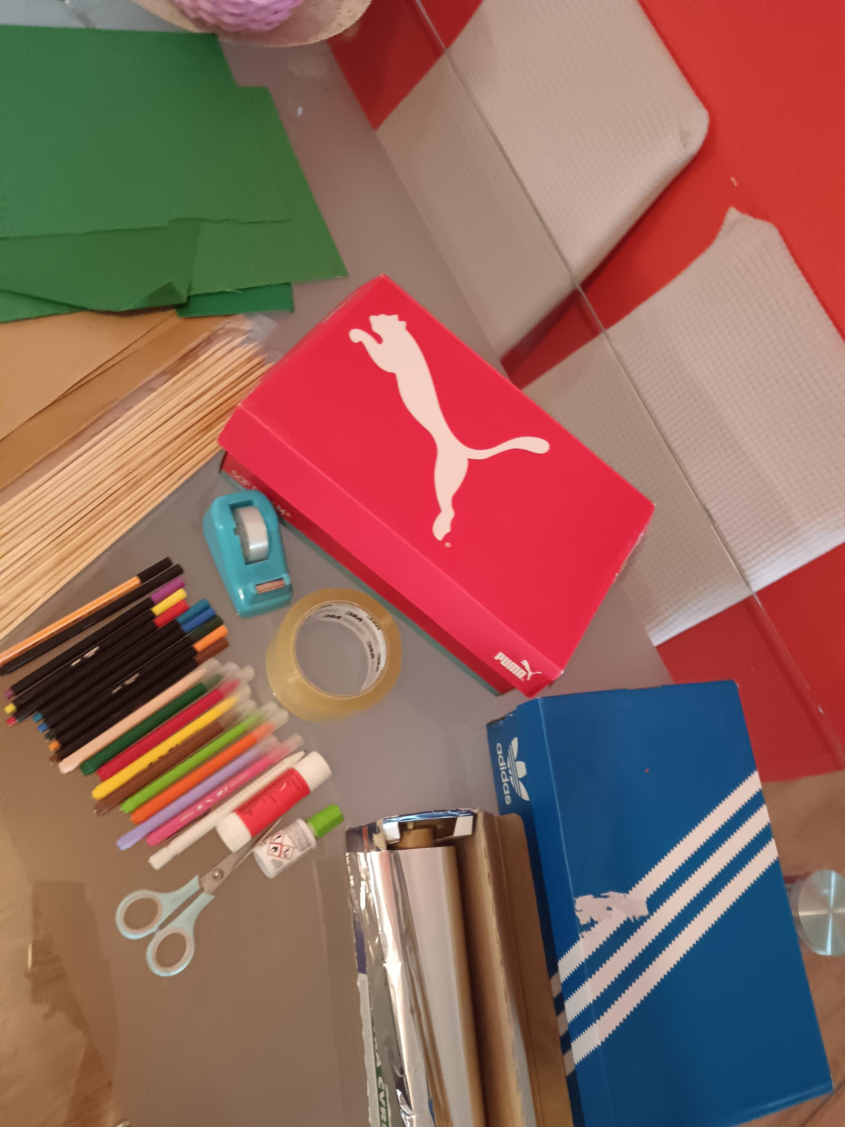
Materials
shoe boxes
green and brown cardboard
sticks
tape
aluminium foil
scissors
paper corrector
markers
pencil
glue

Slide 5
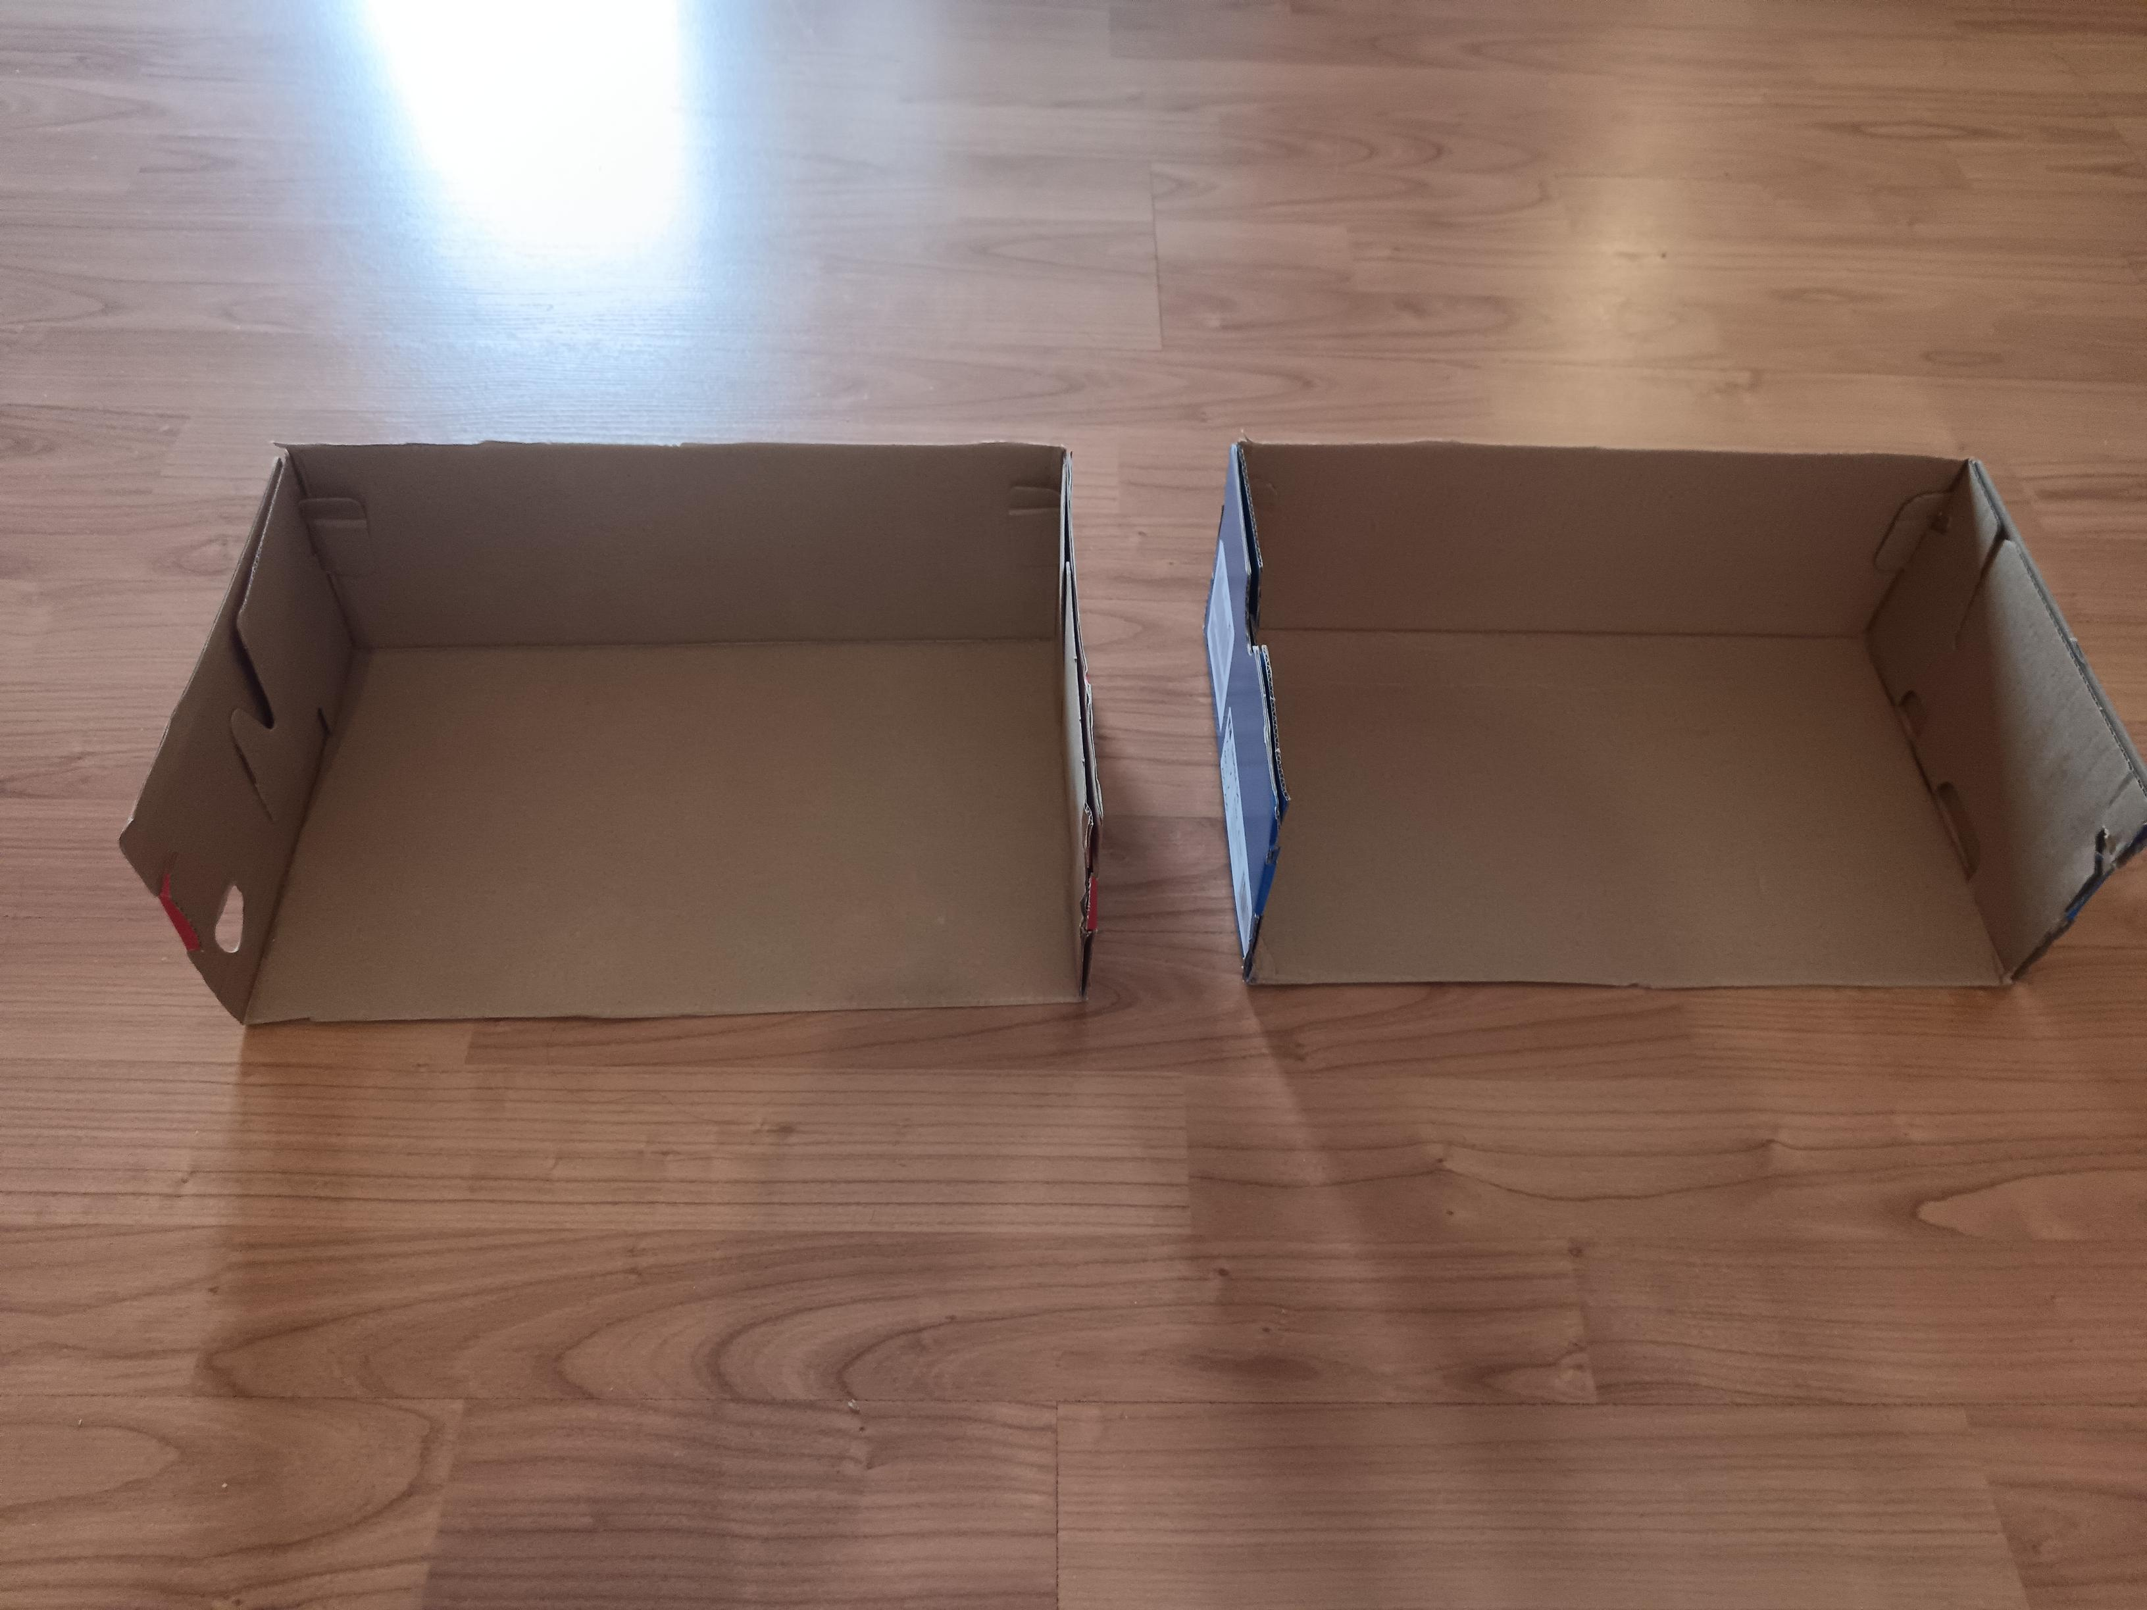
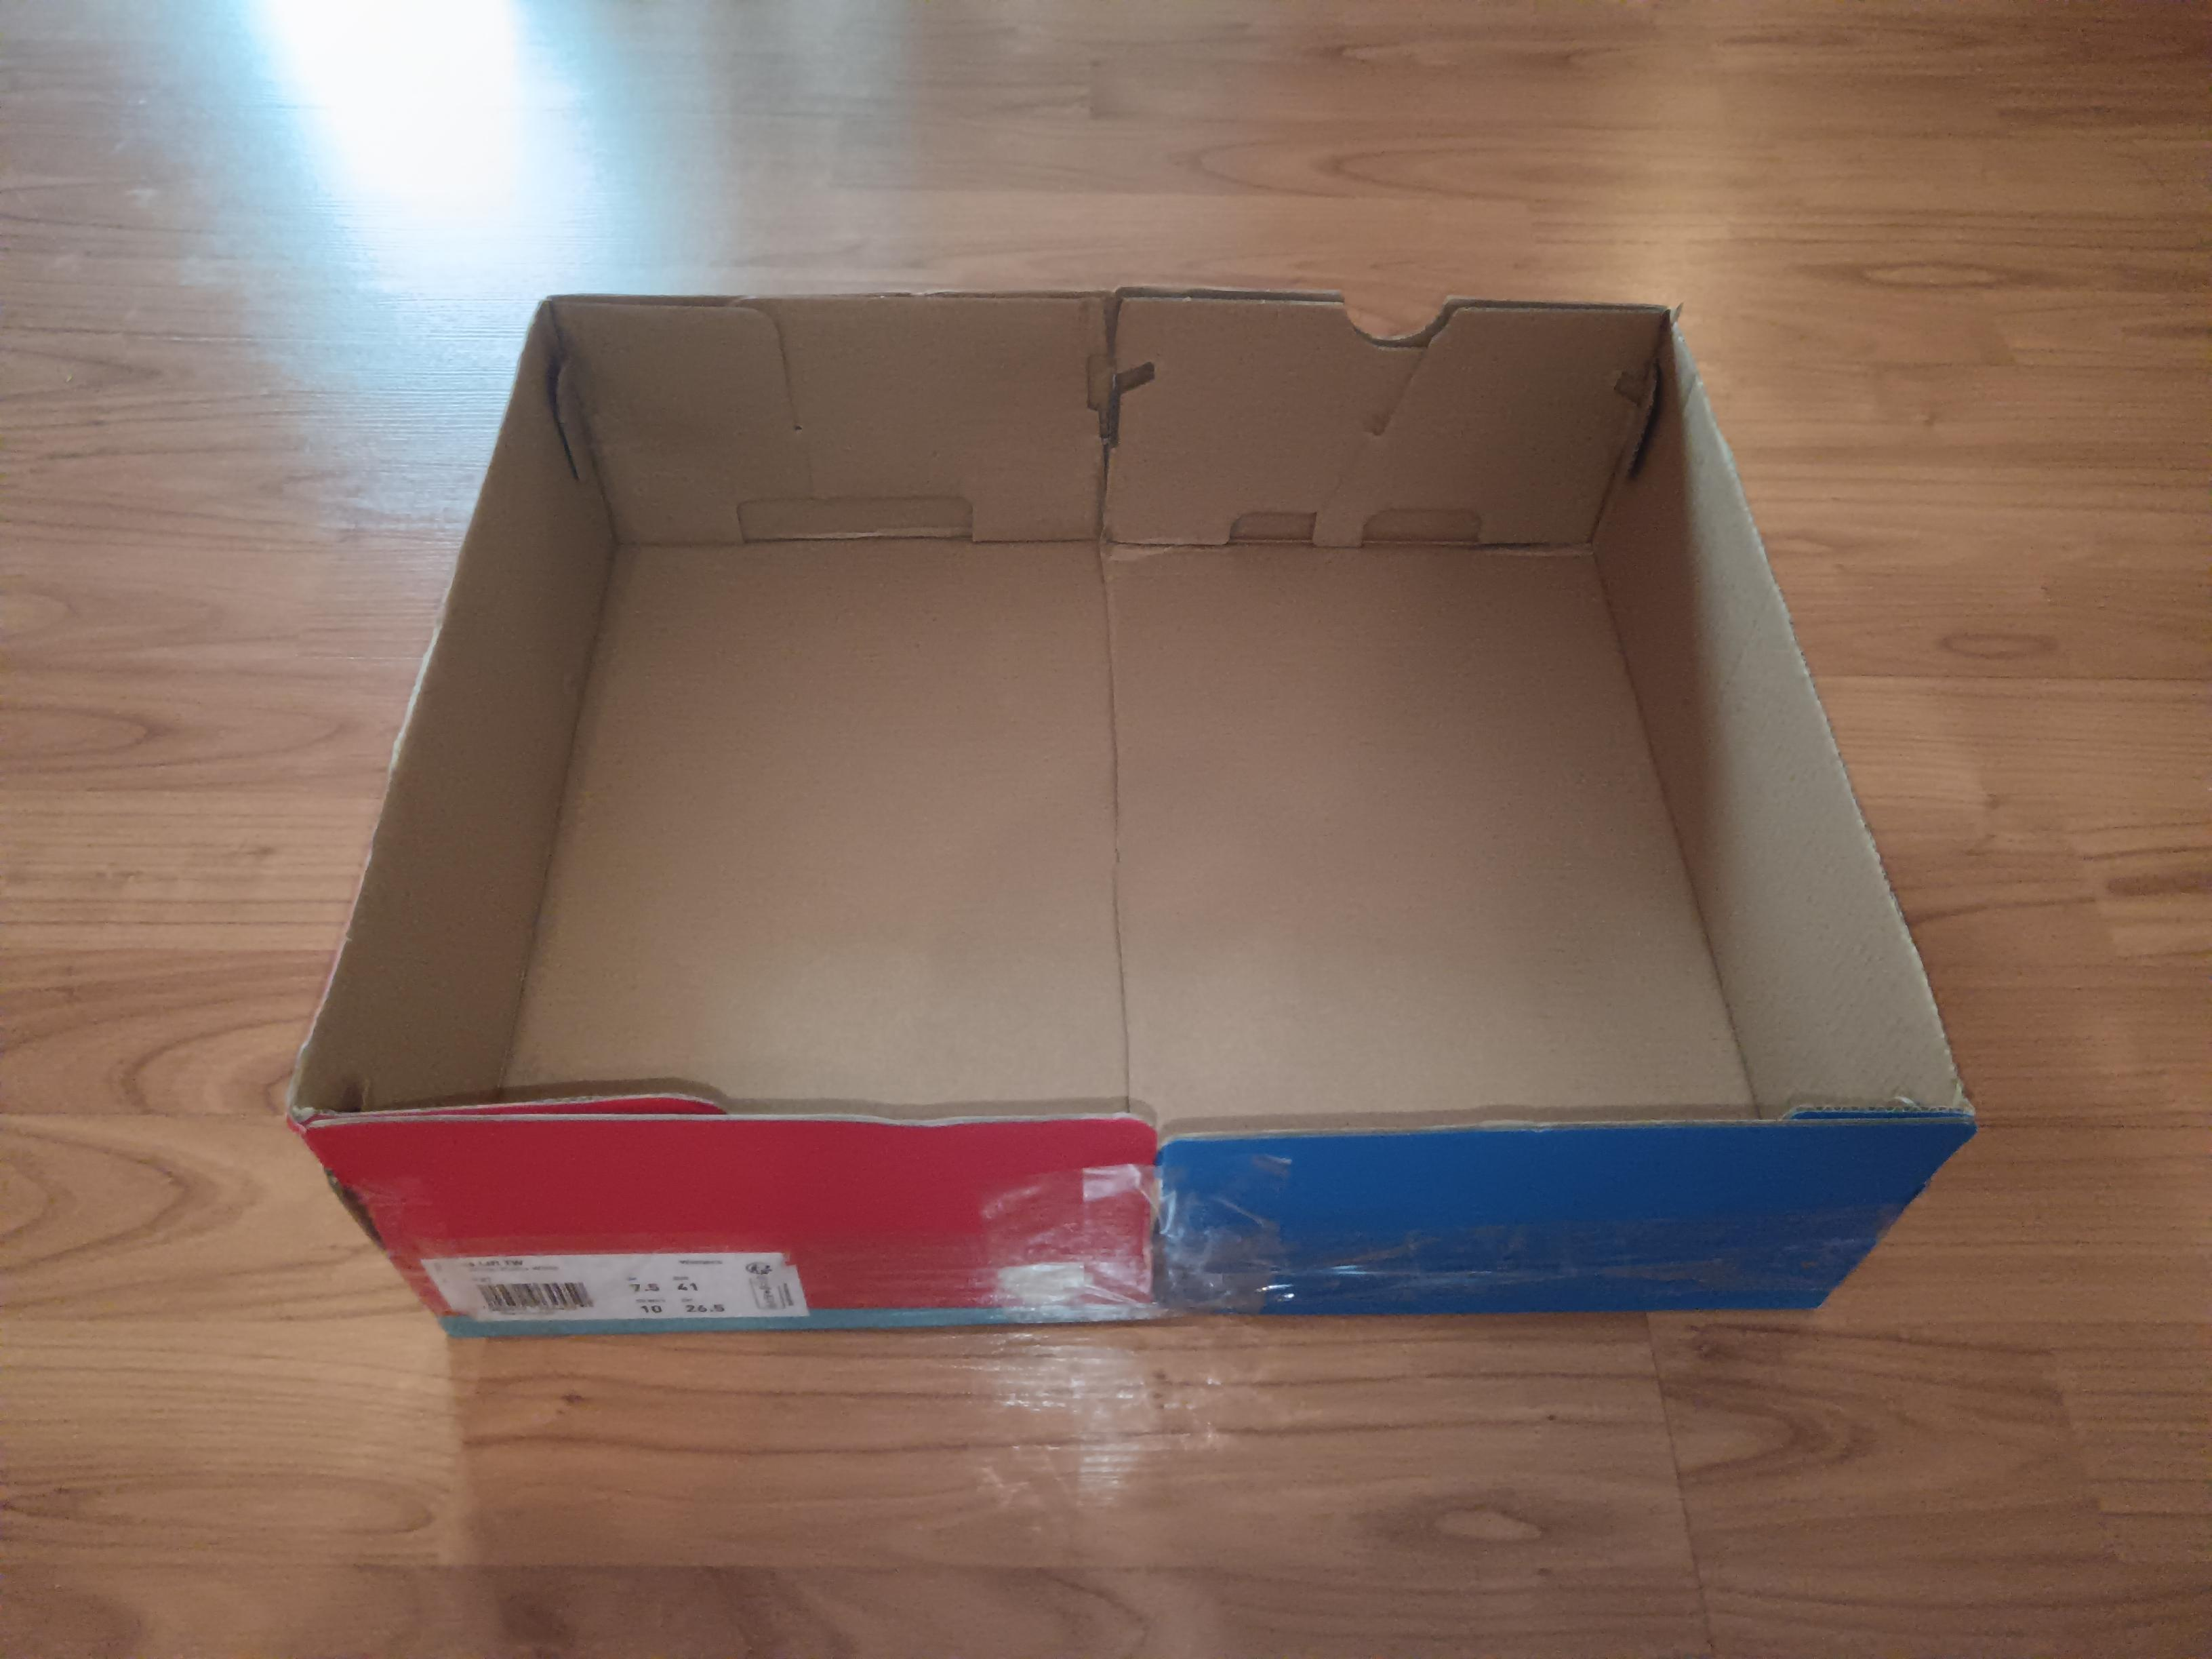
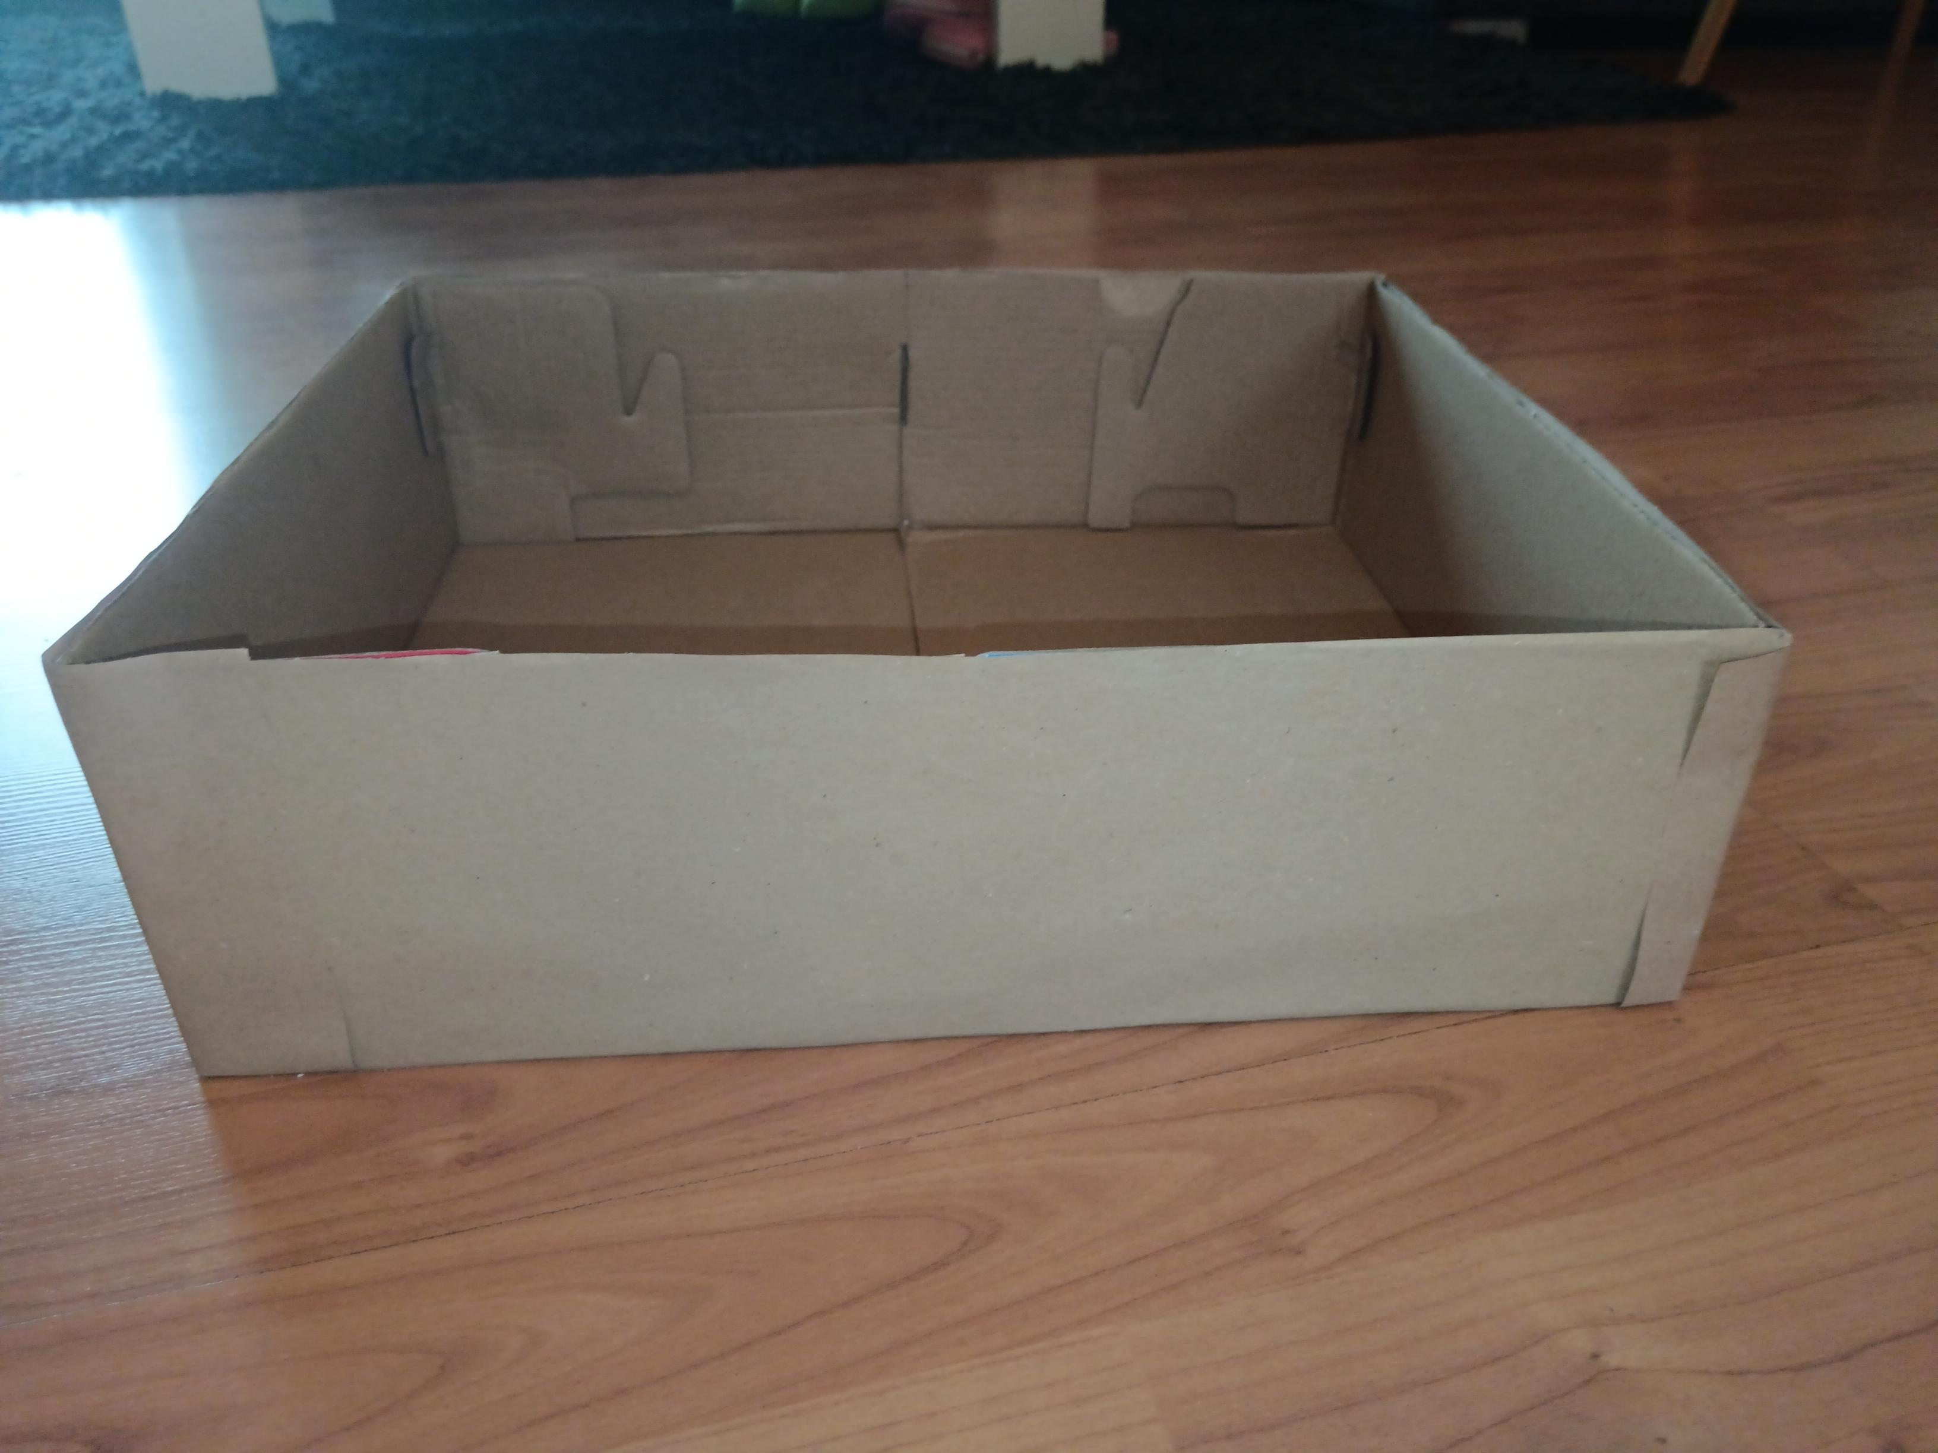
The process of my upcycling project
1. I cut the shoe boxes to the size I needed and taped them together
2. I covered the connected boxes with brown cardboard

Slide 6
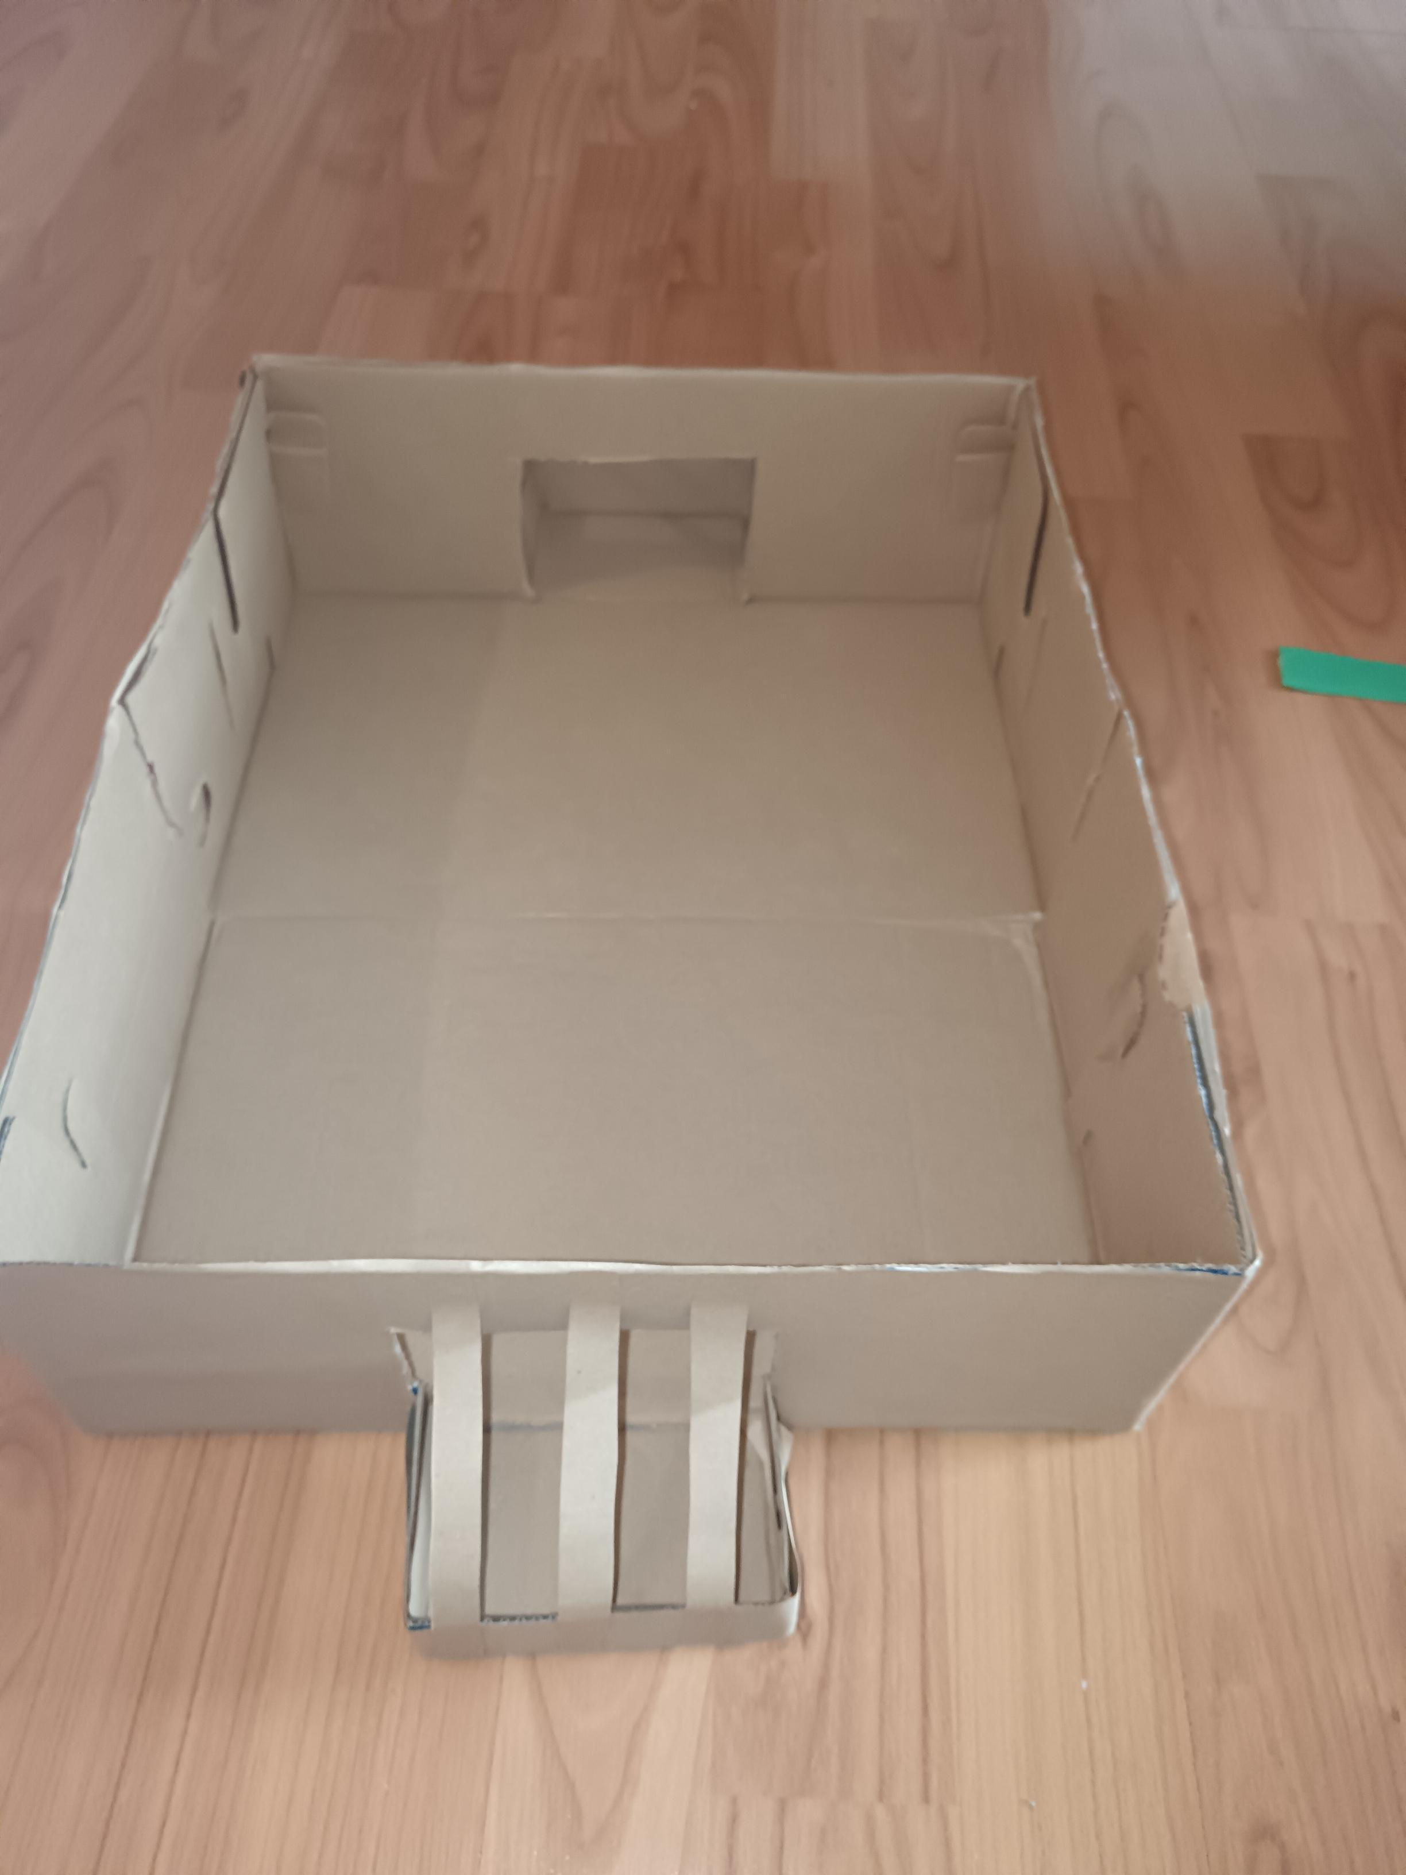
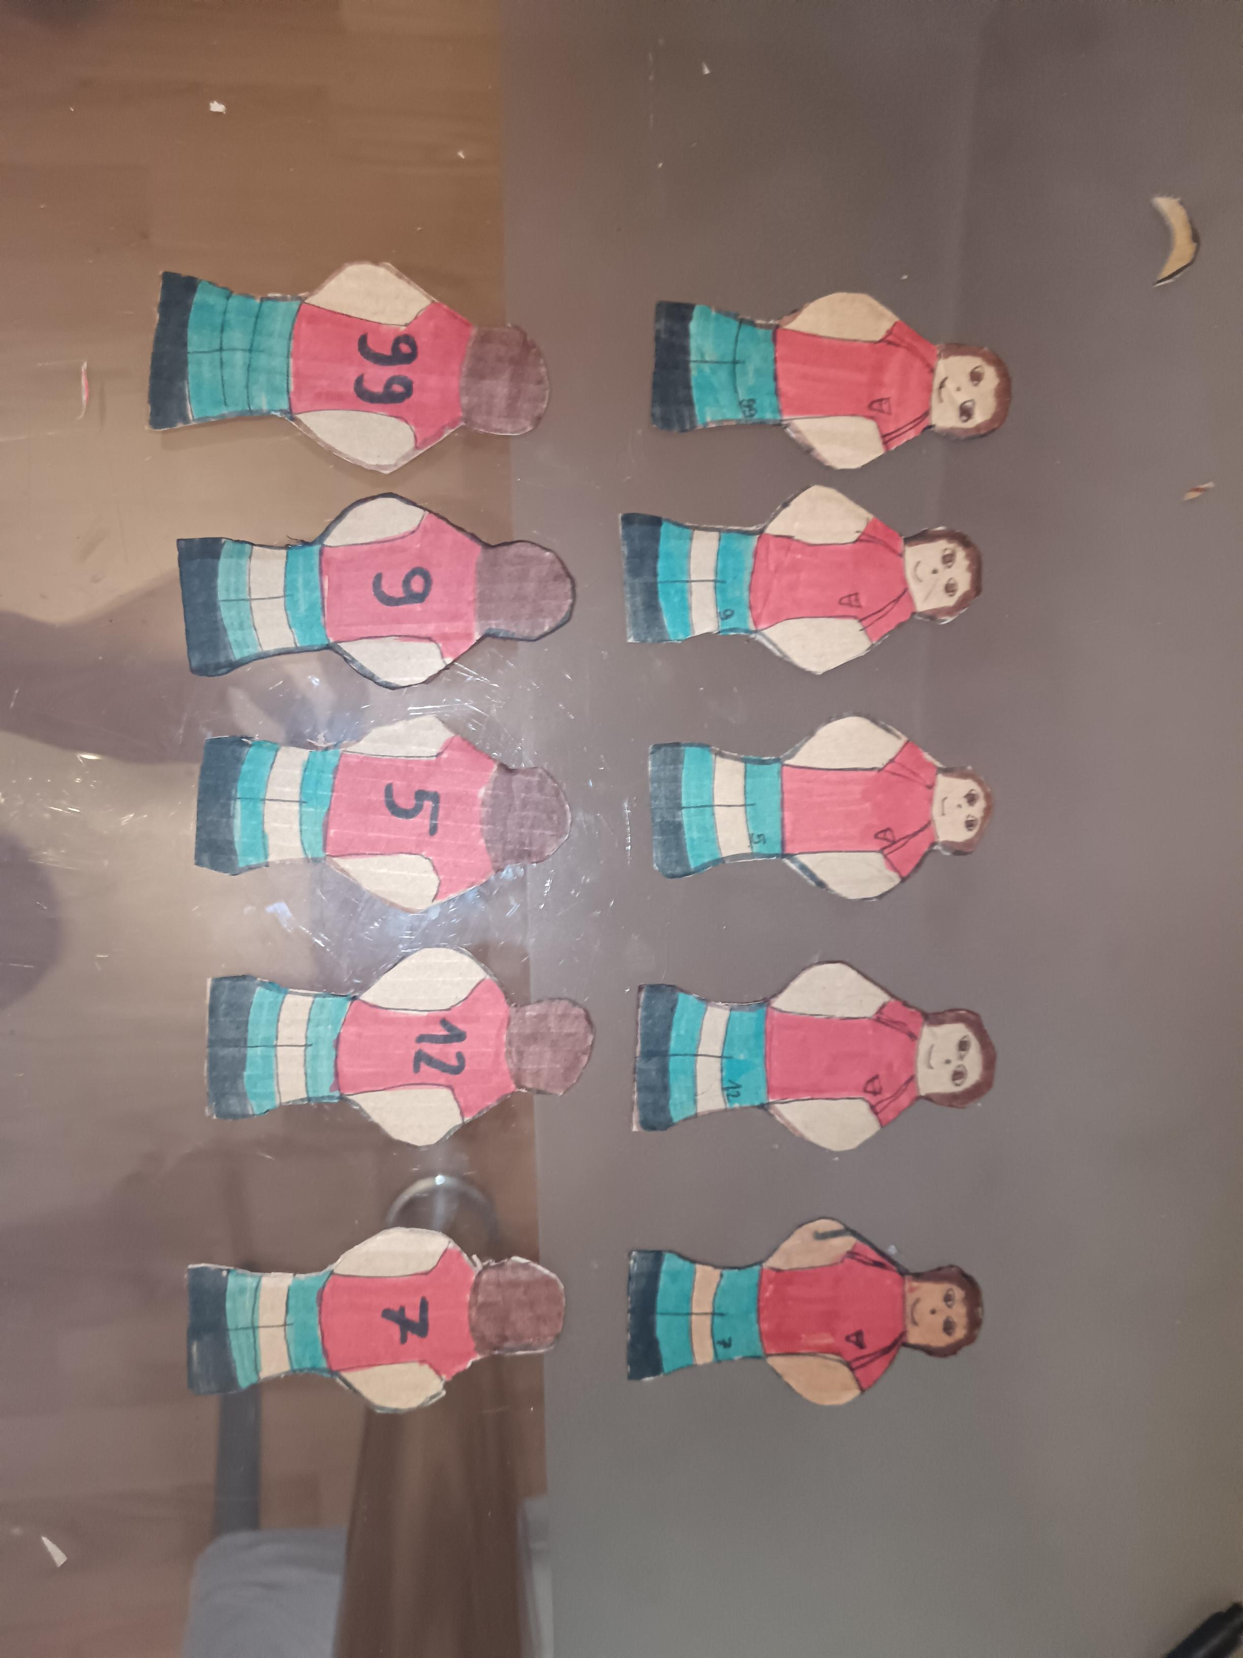
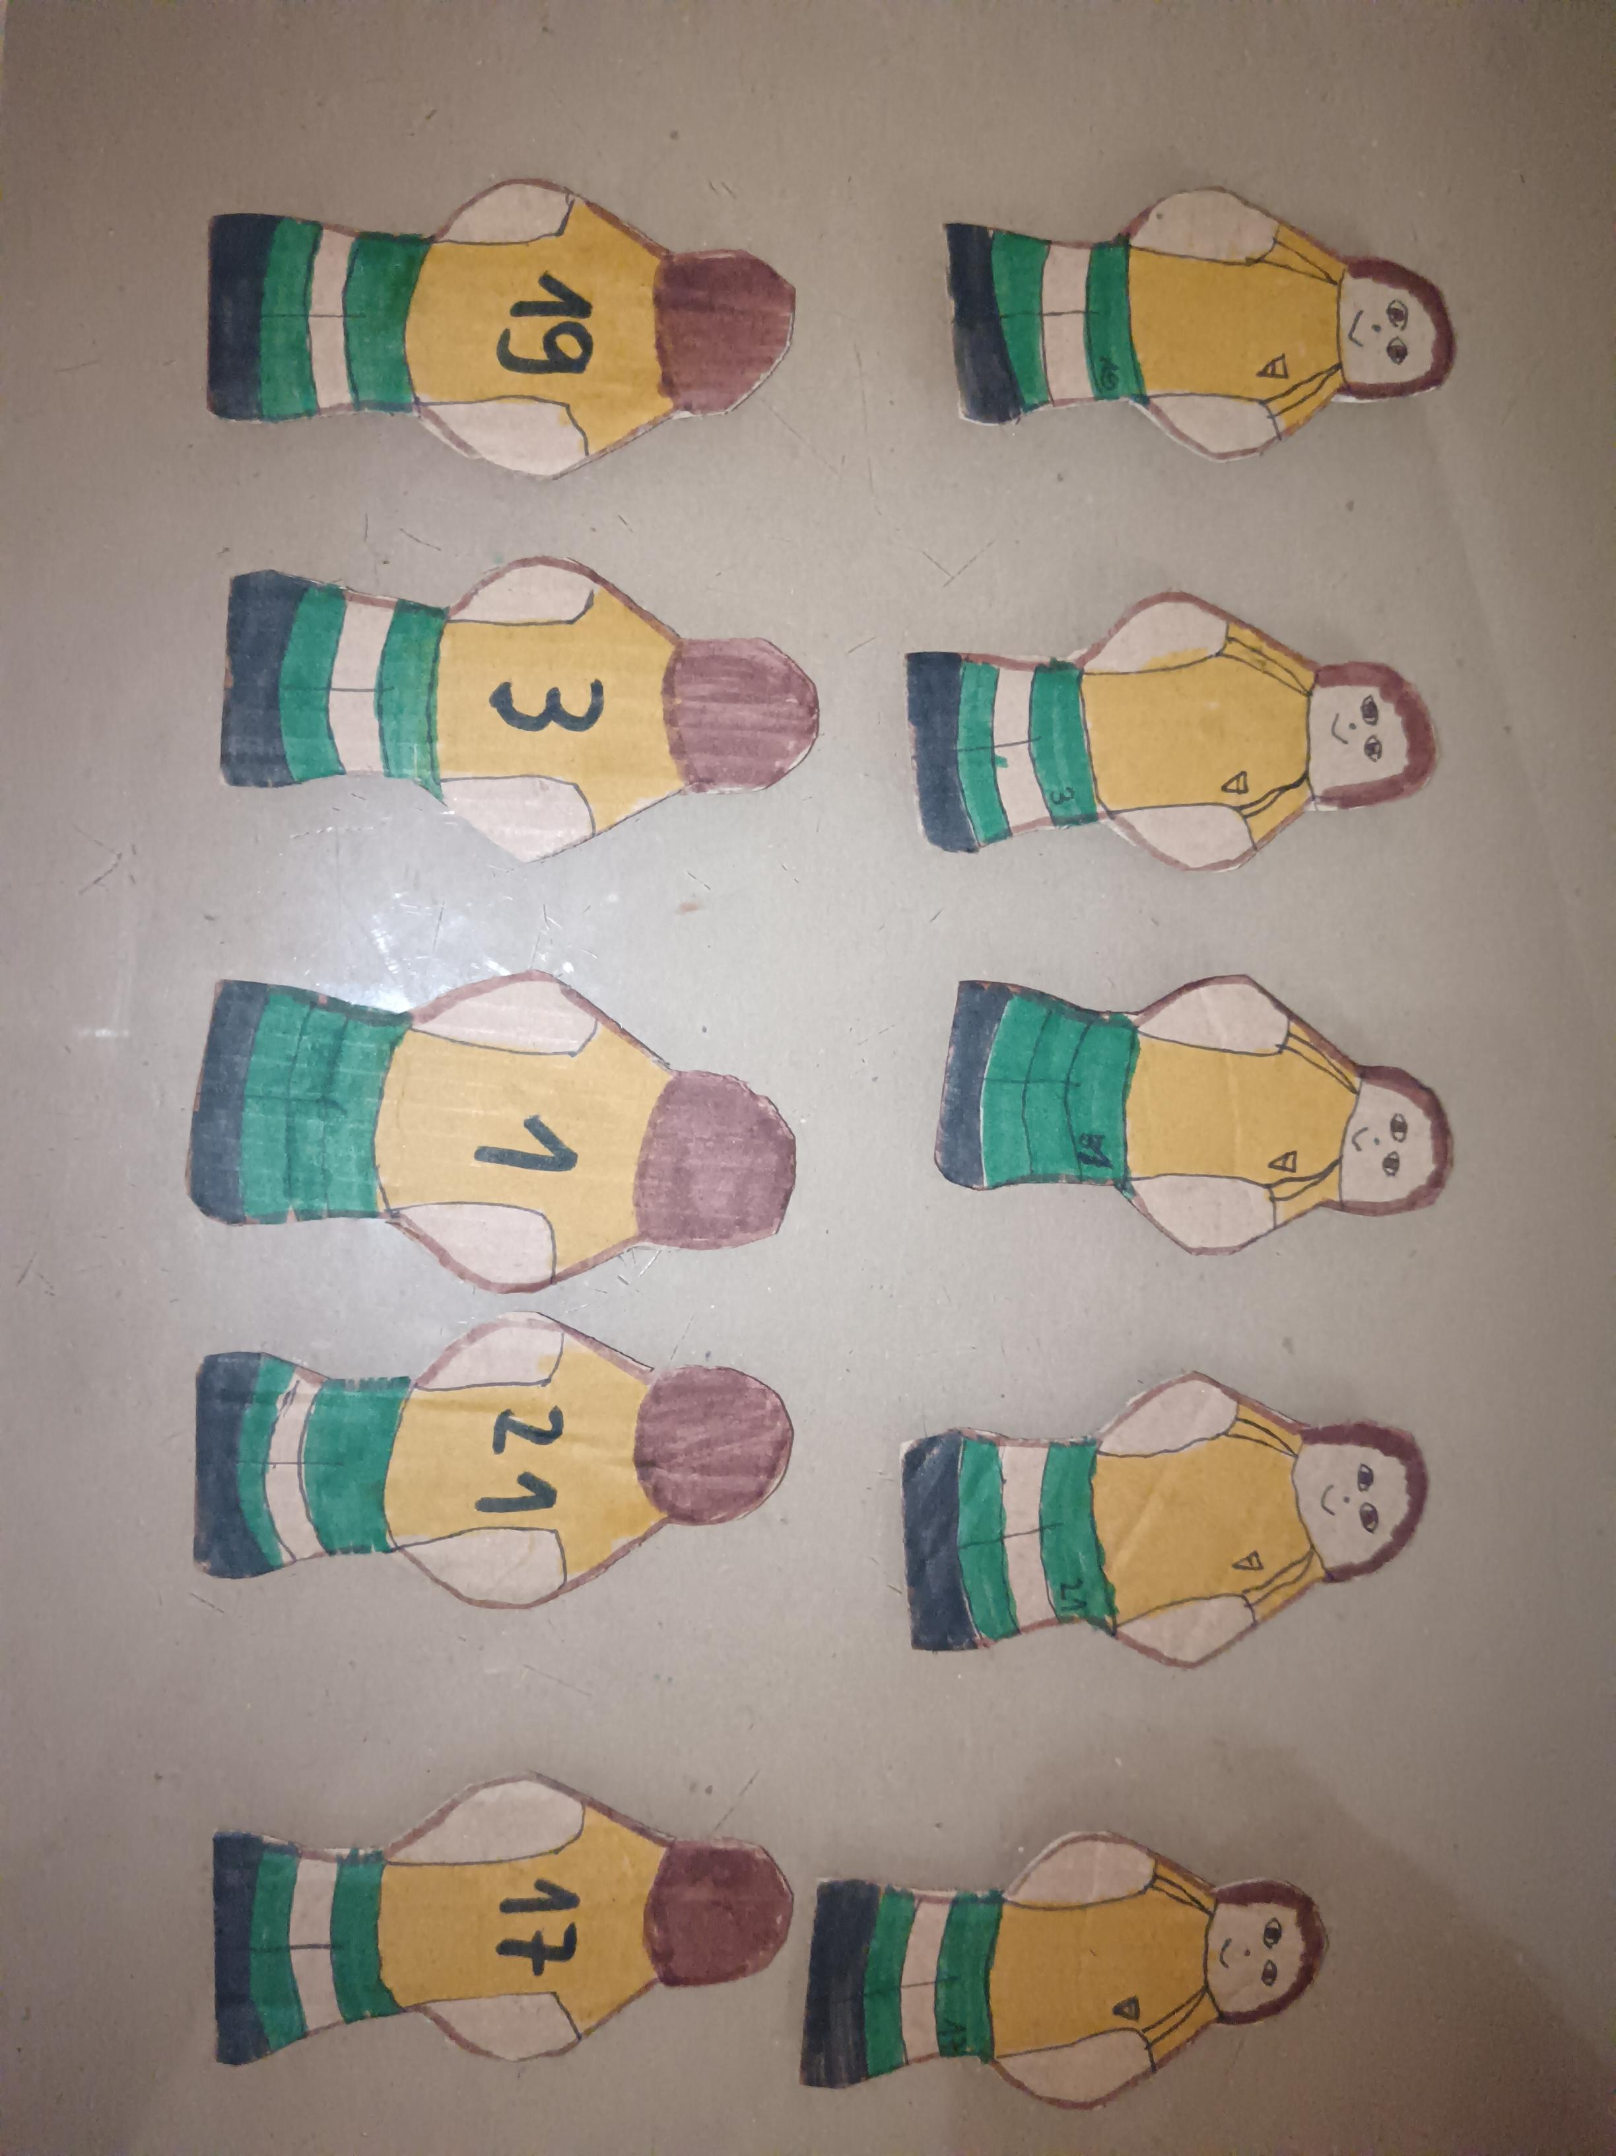
The process of my upcycling project
3. I made 2 teams of 5 players each from leftover shoe boxes and painted them
4. I made 2 goals from leftover shoe boxes, a net out of brown cardboard and glued them together

Slide 7
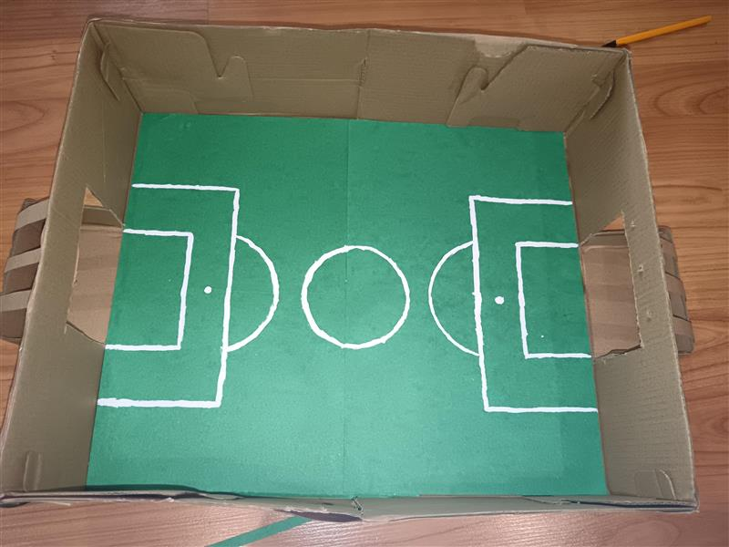
The process of my upcycling project
5. I made a terrain out of green cardboard and used a paper corrector to draw lines like the real terrain has

Slide 8
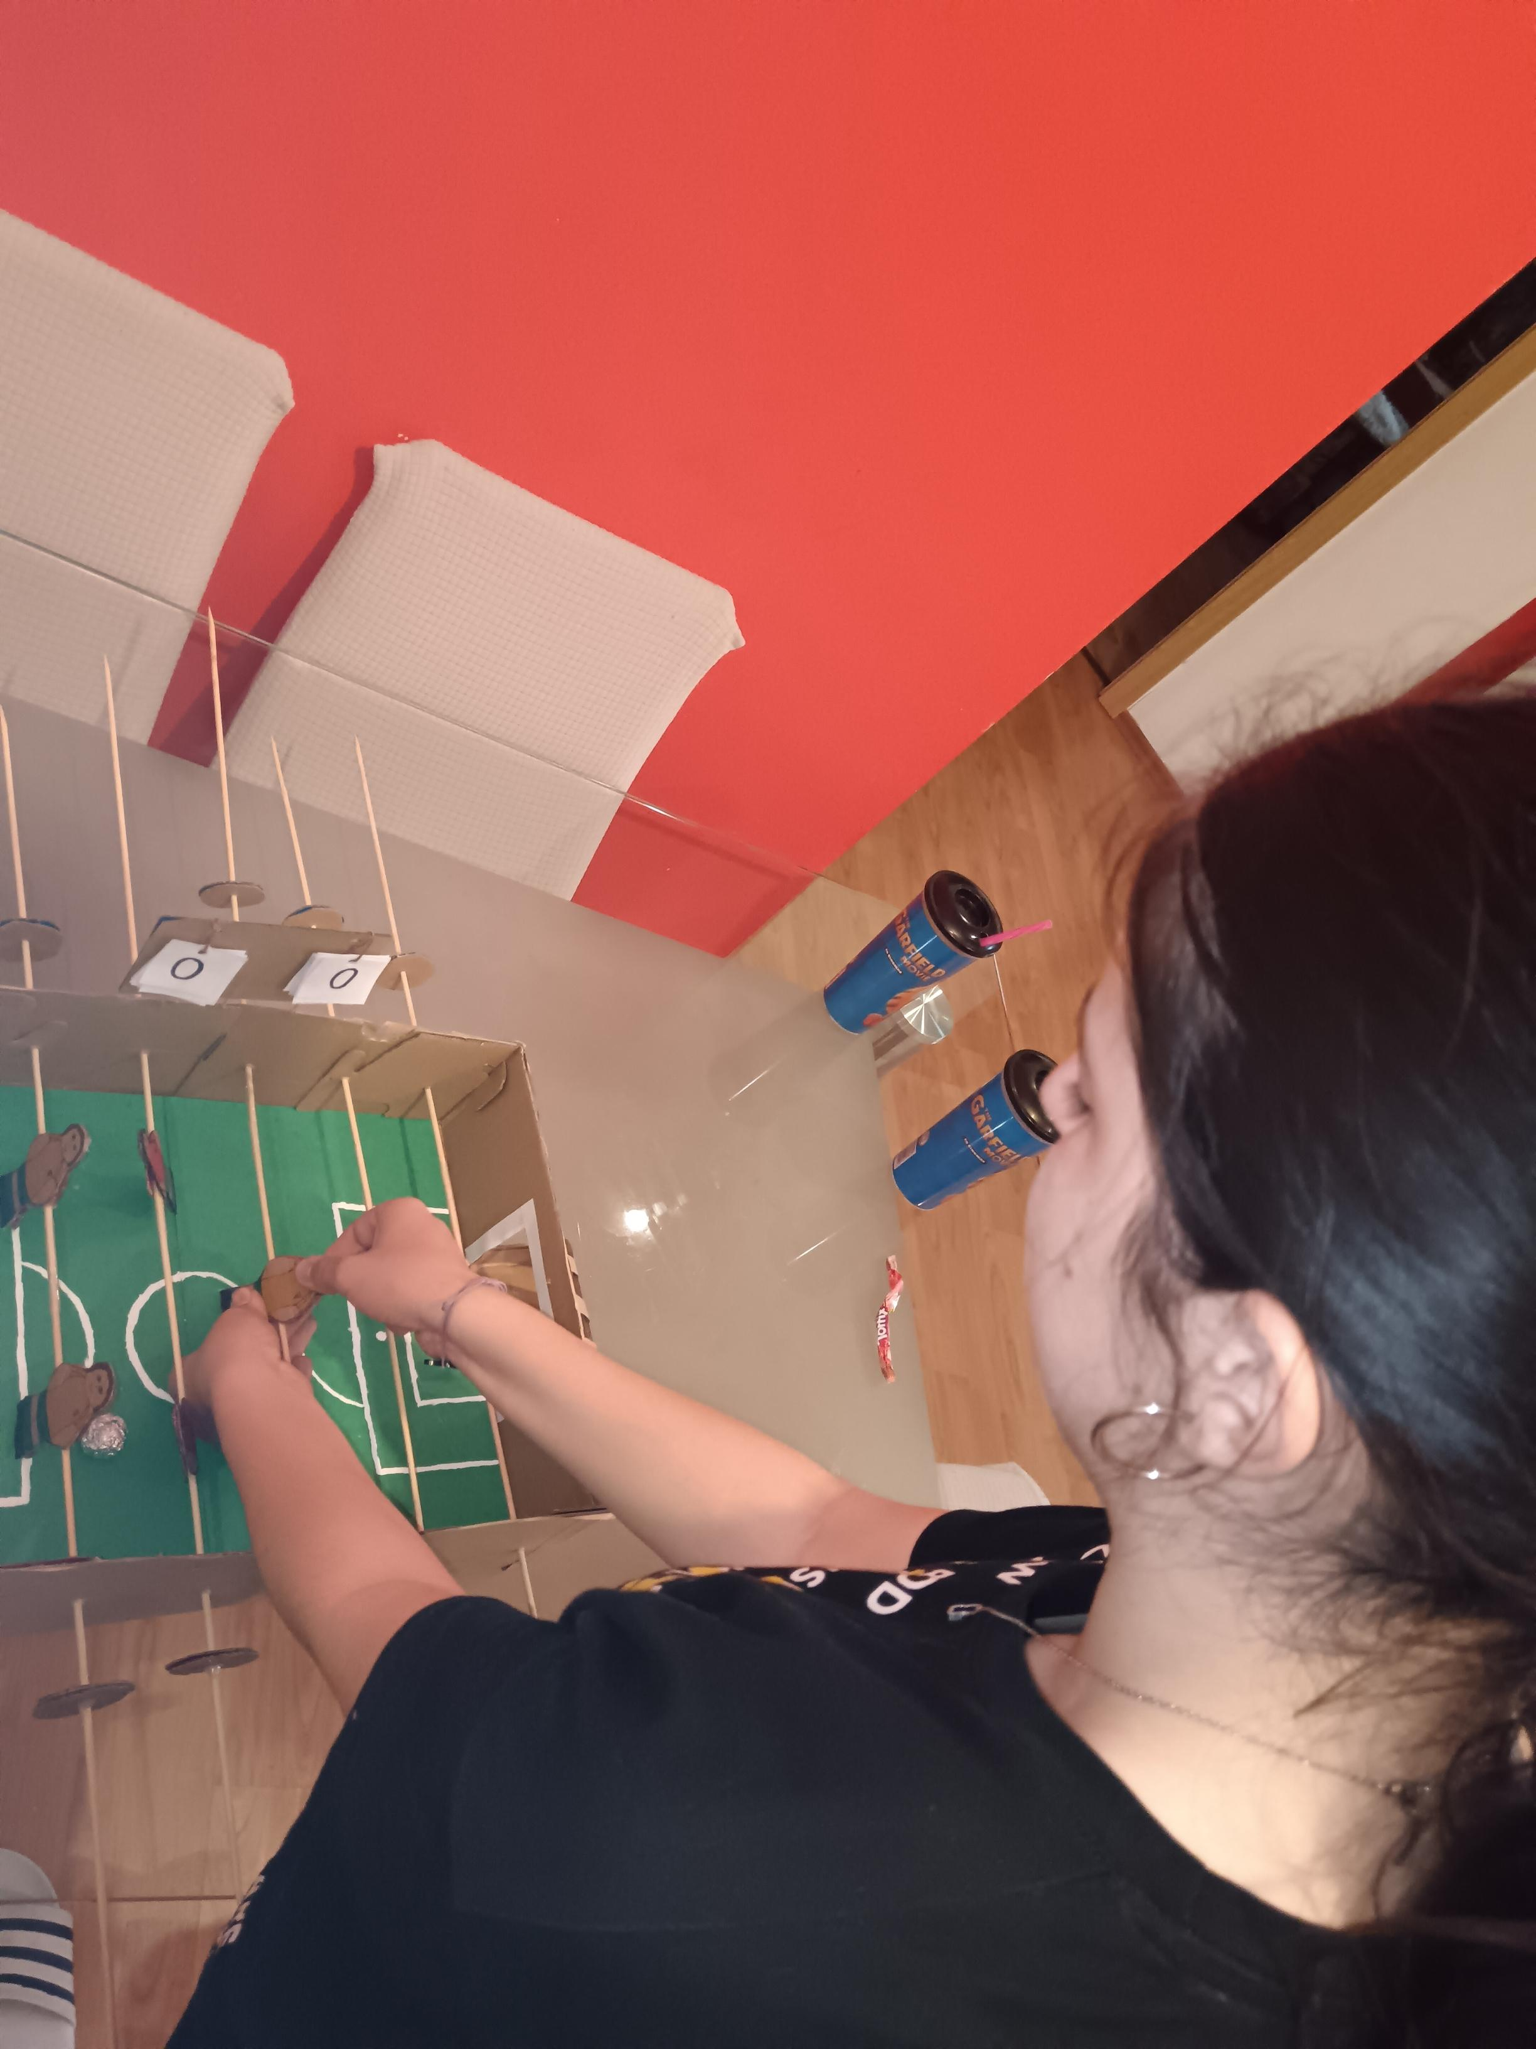
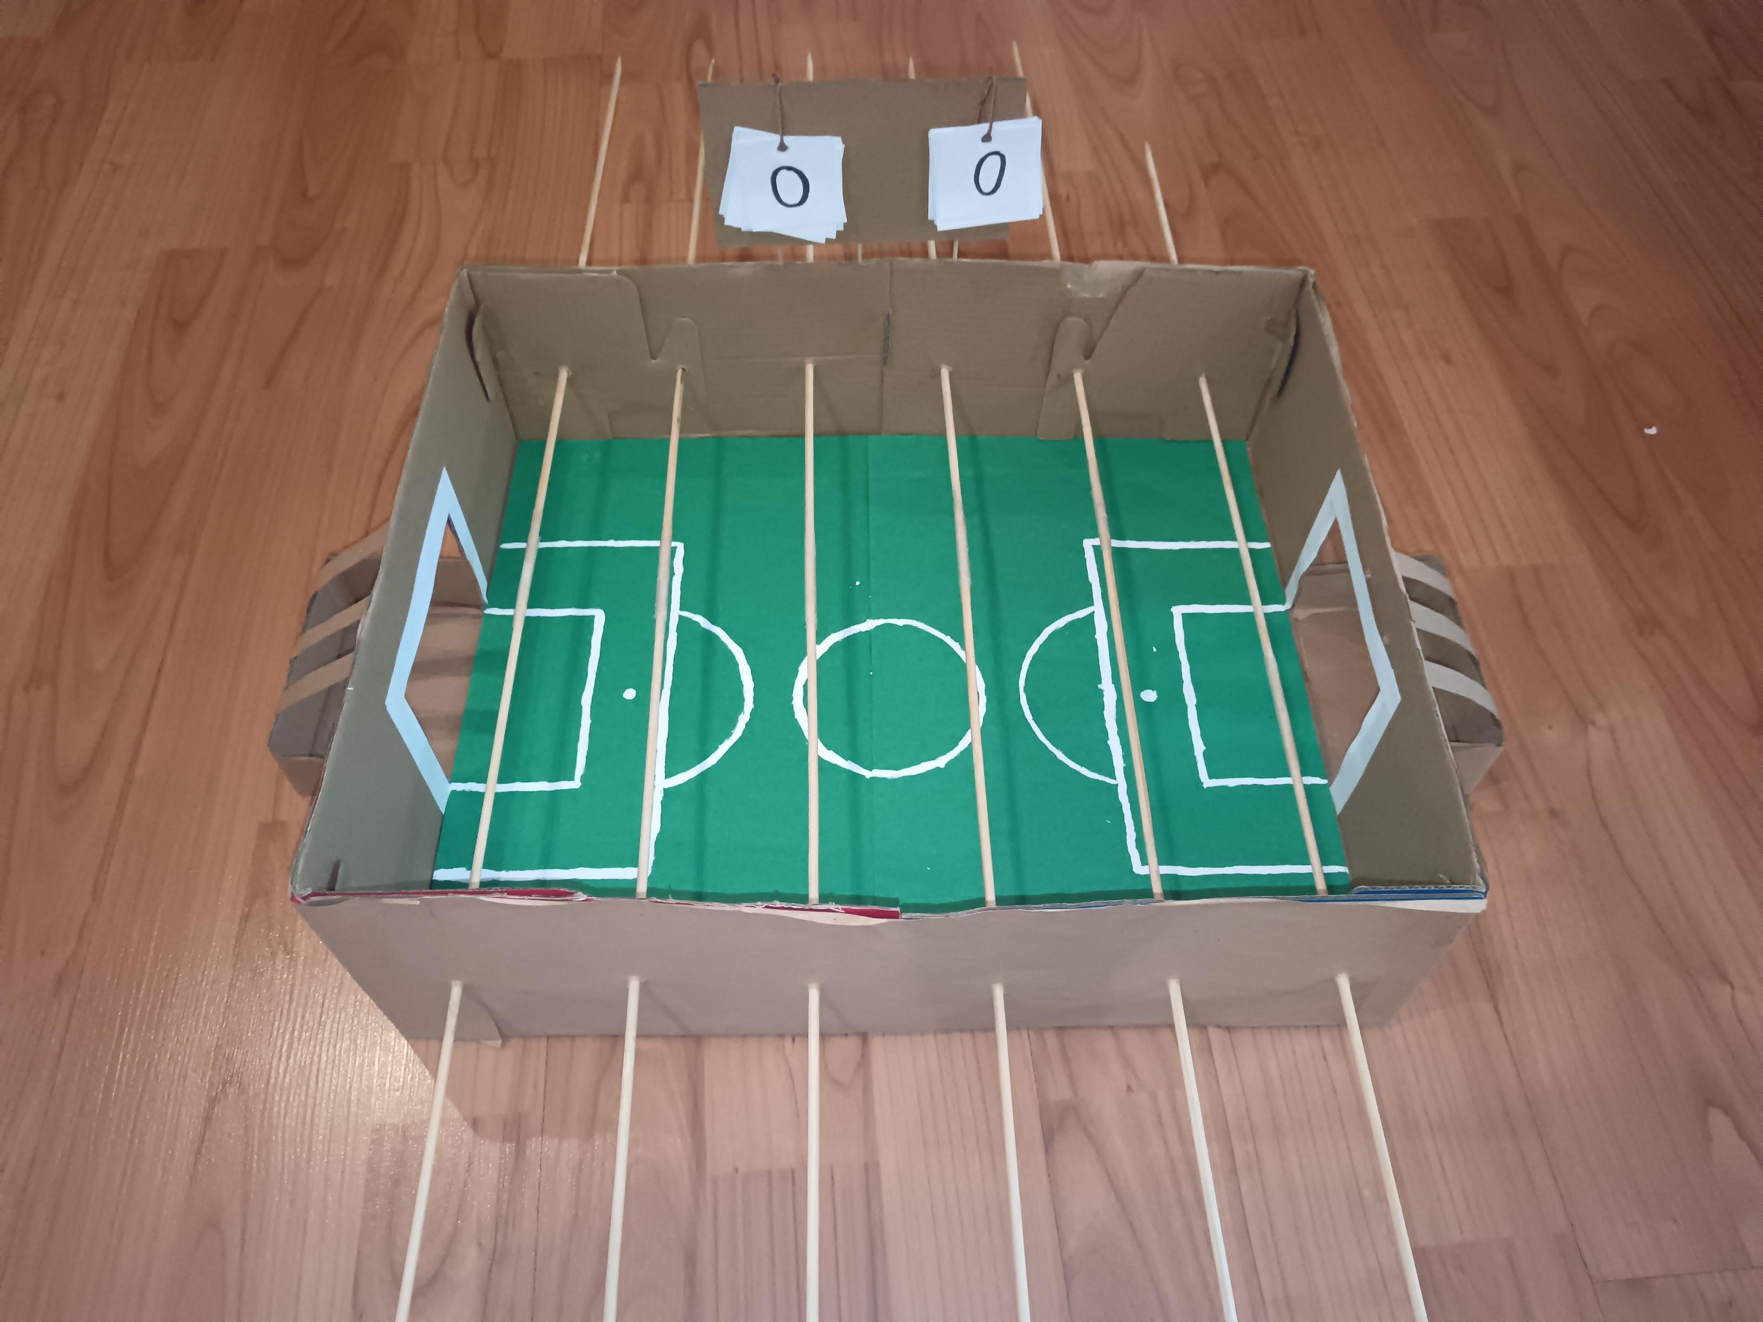
The process of my upcycling project
6. I made a scoreboard out of leftover shoe box and used sticks to put it on
7. I connected 2 sticks and got 1 large stick, I repeated this process 6 times
8. I punched 6 holes on one side and 6 on the other side and put the sticks through them and glued all the players to them

Slide 9
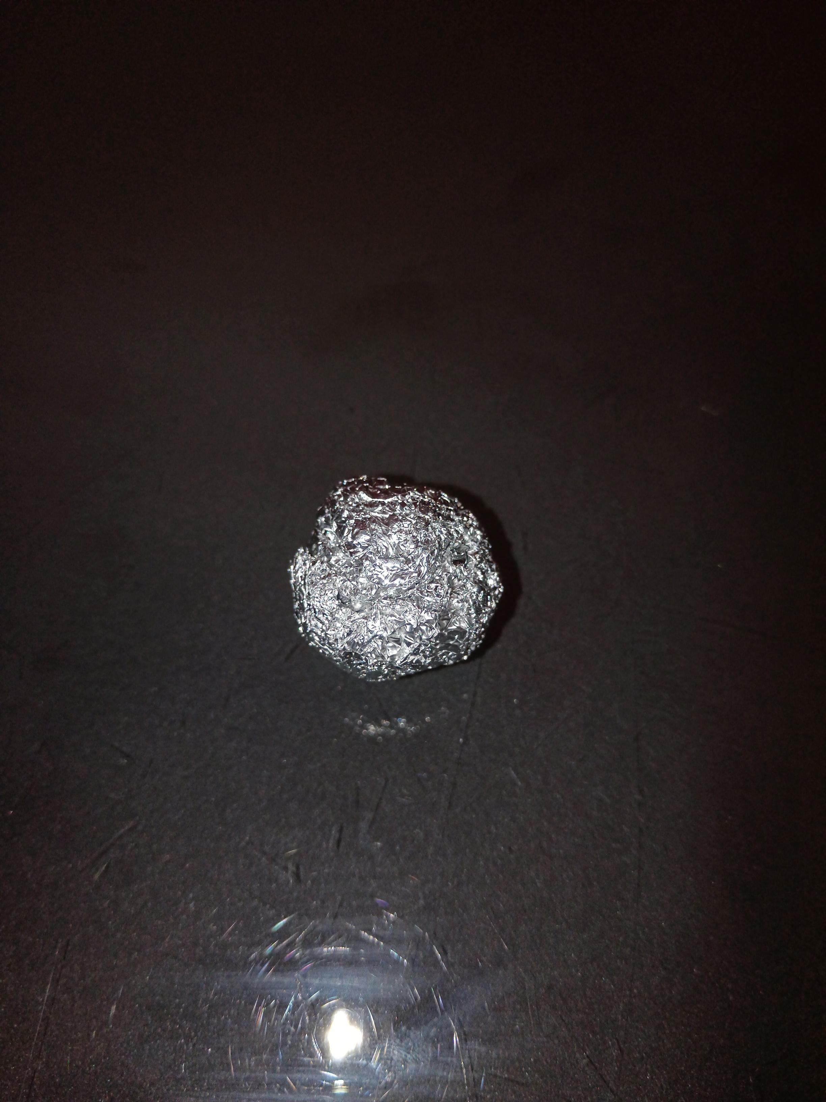
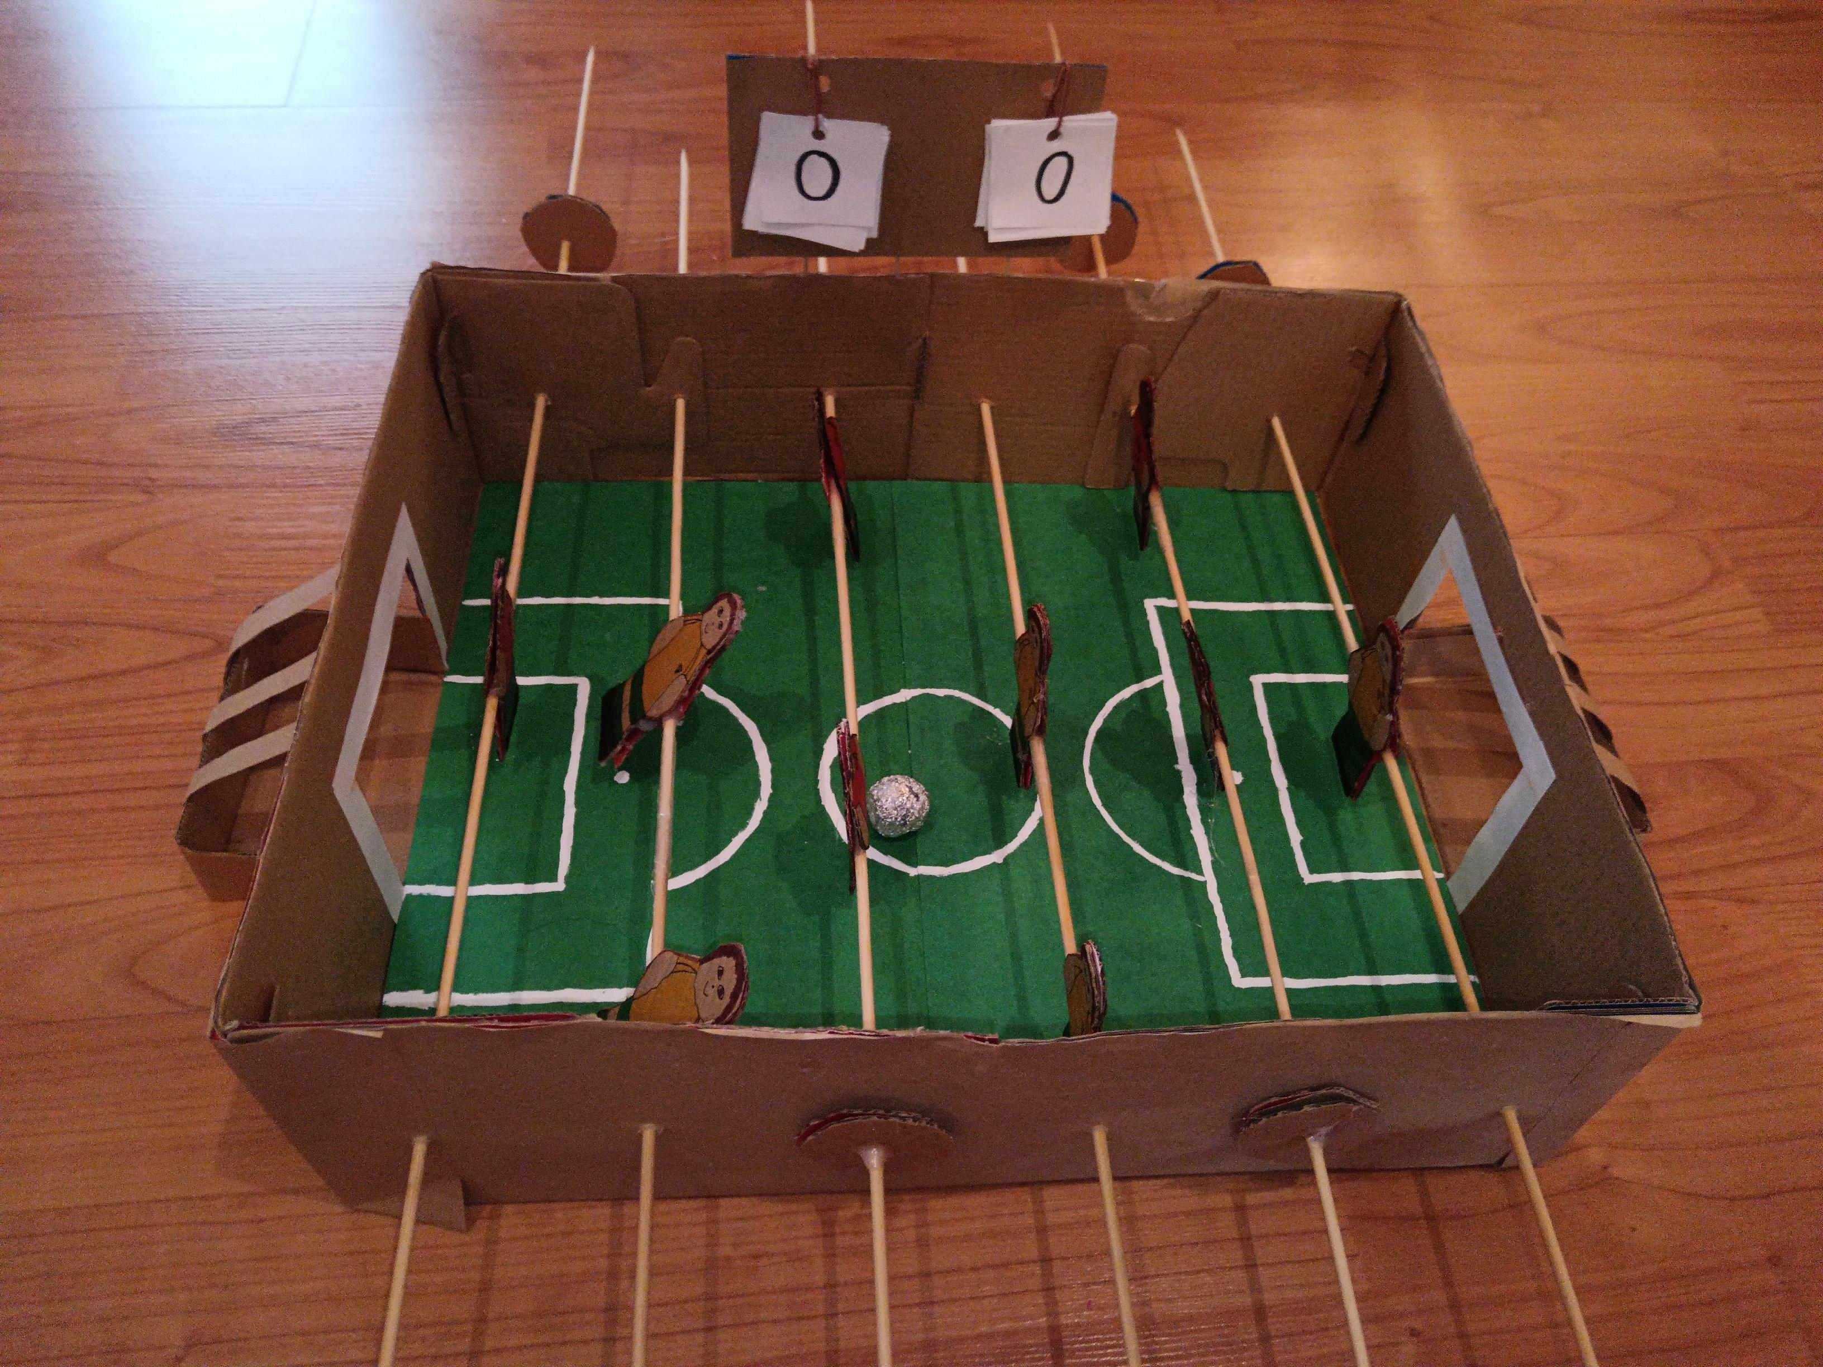
The process of my upcycling project
9. I made 24 circles from the leftover shoe boxes and placed 2 of them on each side of the stick, glued them together, and I got stoppers
10. I took a piece of aluminium foil, crushed it and made a ball

Slide 10
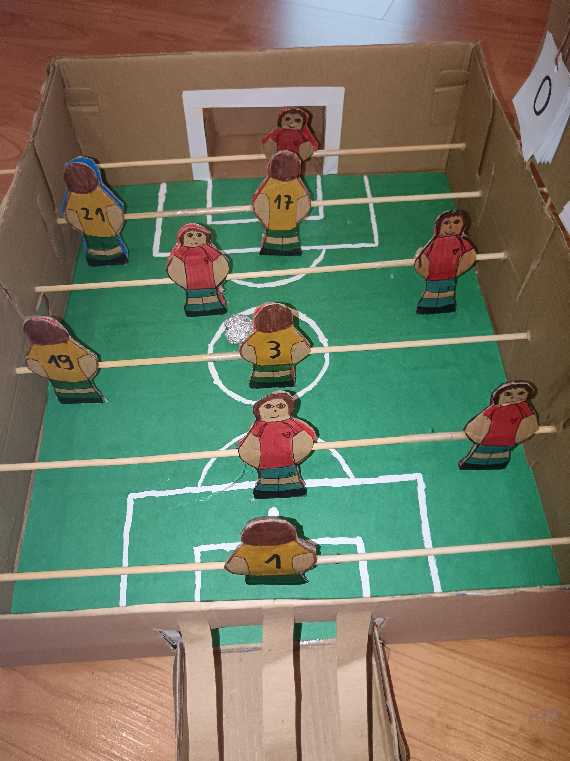
Final result
That's it, my upcycling project is finished
The purpose of my upcycling project is a game

